Slide 1
SITAR modelling of growth in preterm infants and the effect of antenatal steroids
Neil Lawrence

Slide 2
The effect of antenatal steroids on preterm infant growth
Antenatal steroids are excellent at reducing poor short term outcomes
Neonatal death by 31%
Respiratory distress syndrome by 44%
Intraventricular haemorrhage by 46%
Possible negative impact of ADHD and mental health in later life
Previous guidance for potential preterm deliveries <39 weeks altered to <34 weeks

Slide 3
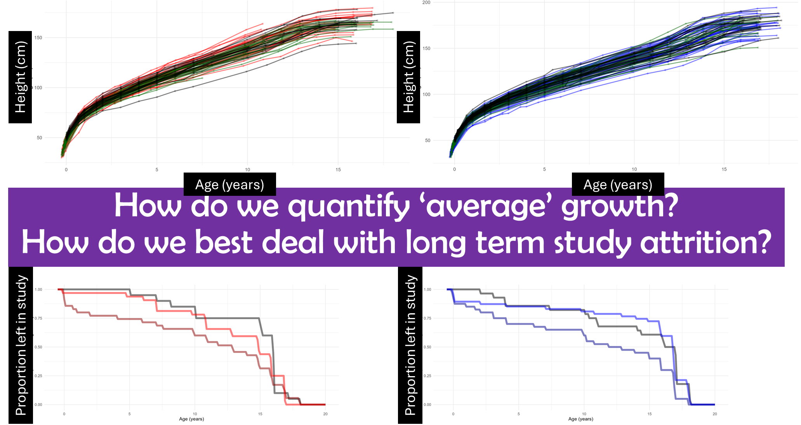

Slide 4

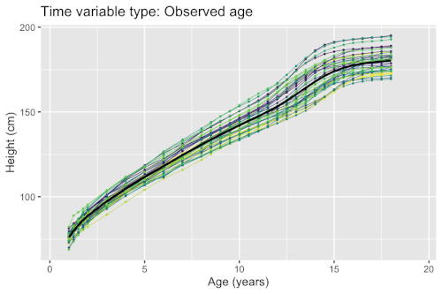

Slide 5
sitar_model <- sitar(
x = ‘natural_log_age’,
y = ‘height’,
id = ‘id’,
data = ‘data_frame’,
df = 12 )

Slide 6
Population level ‘fixed effects’ – the ‘average’ growth
sitar_model <- sitar(
x = ‘natural_log_age’,
y = ‘height’,
id = ‘id’,
data = ‘data_frame’,
df = 12 )
Log-likelihood: -2941.496
Fixed: s1 + s2 + s3 + s4 + s5 + s6 + s7 + s8 + s9 + s10 + s11 + s12 + a + b + c ~ 1
s1 s2 s3 s4 s5 s6 s7 s8 s9
24.6 35.8 45.1 55.6 61.6 72.8 82.8 94.9 107.9
s10 s11 s12 a b c
128.8 139.9 126.7 33.2 -0.01 0.06
Random effects:
Formula: list(a ~ 1, b ~ 1, c ~ 1)
Level: id
Structure: General positive-definite, Log-Cholesky parametrization
StdDev Corr
a 5.36 a b
b 0.08 0.76
c 0.05 0.74 0.37
Residual 1.43
Distribution of random effects across the population

Slide 7

ranef(sitar_model)
sitar_model <- sitar(
x = ‘natural_log_age’,
y = ‘height’,
id = ‘id’,
data = ‘data_frame’,
df = 12 )
Extract model random effects
‘a’
‘b’
‘c’
SIZE
TIMING
VELOCITY

Slide 8
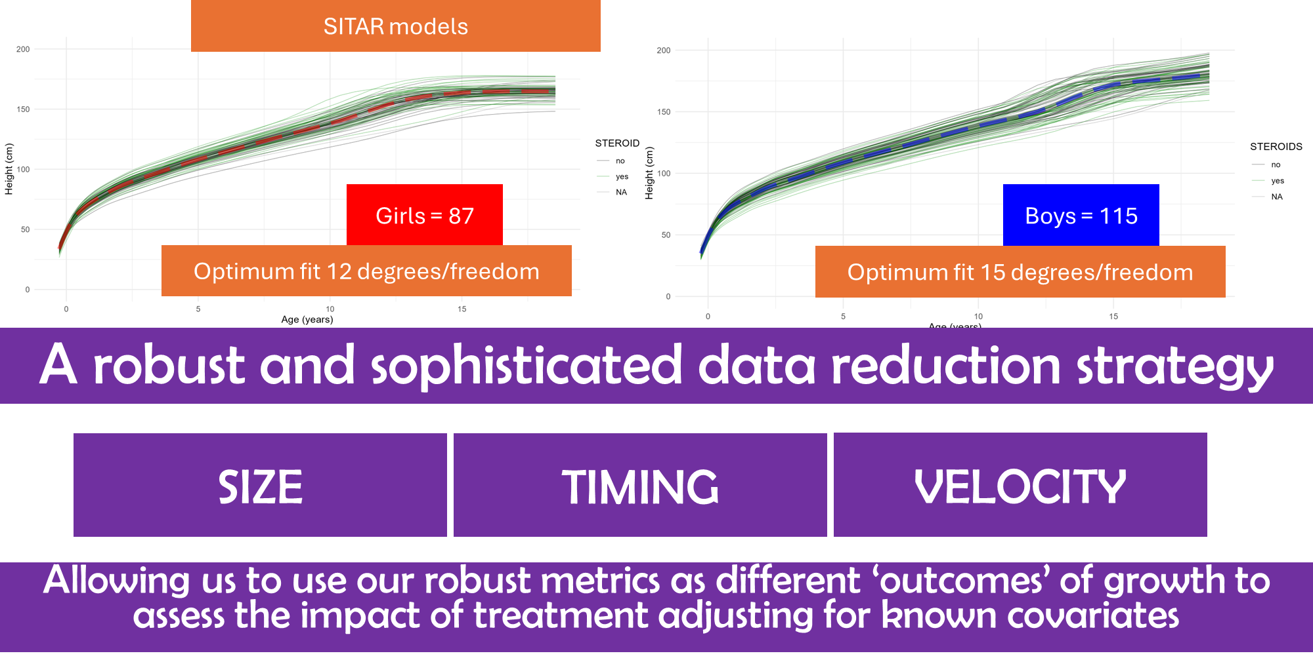

Slide 9
Growth outcomes
Treatment and covariates
SIZE
Antenatal steroids
TIMING
Maternal height
VELOCITY
Paternal height
Base R!
Gestational age at birth

Slide 10
Outcome variable = a : ‘size’
Girls
Boys
Flextable / officer packages

Slide 11

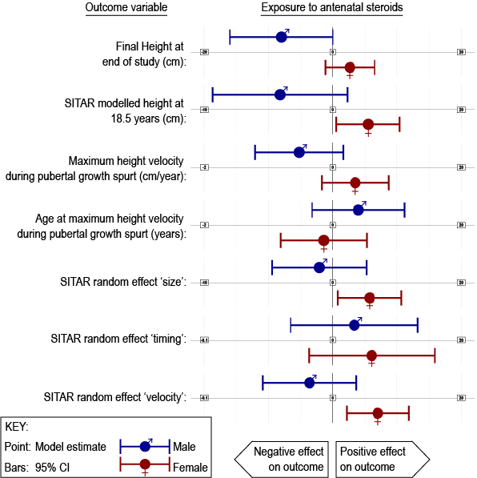

Slide 12
Problems:
Explainability!
Defining uncertainty around individual patient random effects
Post hoc estimation of individual random effects without the fitting of a new model

